Slide 1
Team Old Iron

Slide 2
Background
Value of graph data:
Personal recommendation
Price prediction
Communication anomaly detection.

Slide 3
Extracting Features From Knowledge Graph
Given knowledge graph
To build prediction models -> We first have to learn the latent semantic for each user (node).
One of the strongest strategy: Graph embedding

Slide 4
Graph embedding
Concept: Two users that have similar personality -> Two vectors that have high cosine similarity

Slide 5
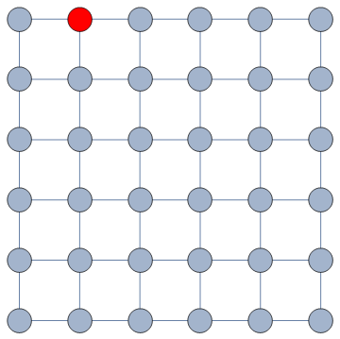
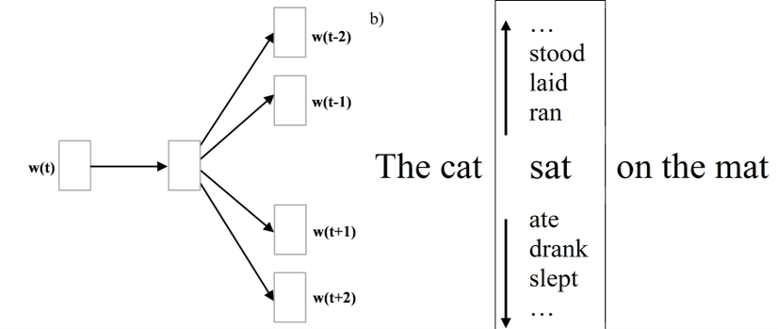
Graph embedding: Strategy
Random walk + Skip-gram

Slide 6
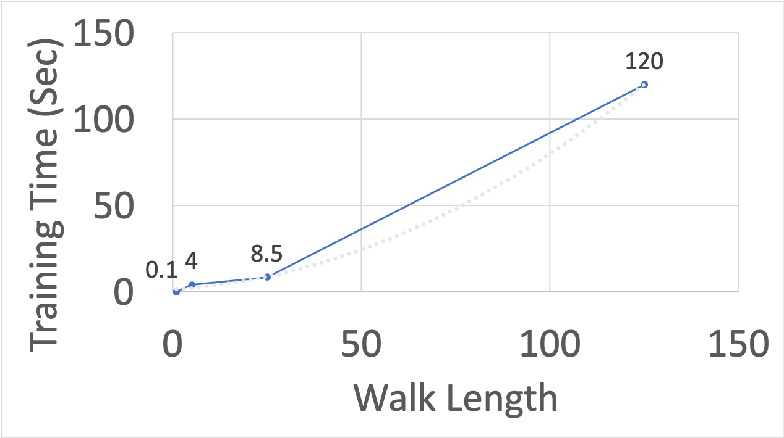
Graph Embedding Sounds Perfect, Yet…
Graph embedding models has non-linear complexity
Time comparison with different walk length (UK)

Slide 7
Graph Embedding Sounds Perfect, Yet…
Aron is the marketing leader for a start-up company that sells antique:
Working on maximizing the profit through recommending system
Had collected significant amount of user data
Decide to use graph embedding to extract user feature
Aron
Marketing leader for a start-up company

Slide 8
Problem
Unlike large company -> Unlimited computational resource
A start-up has limited computational resource

Slide 9
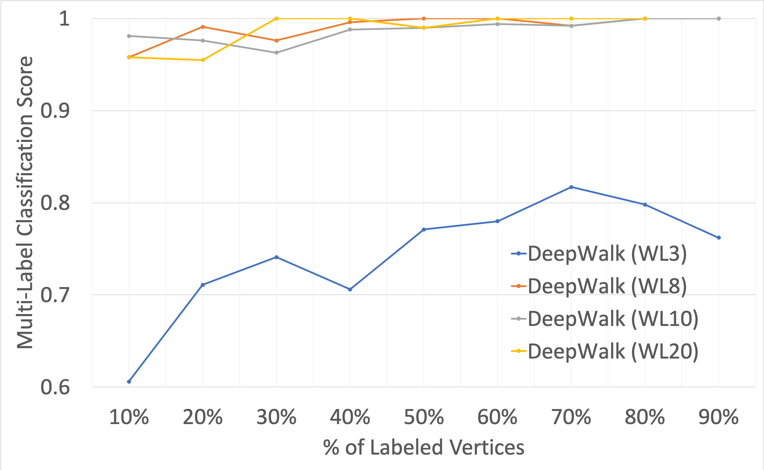
Why Computational Resource is Important?
More resource, more accurate
Large companies
Small companies
Model performance with different walk length (UK)

Slide 10
How Can We Improve?
Previous works -> Same amount of random walk sampling resource for each node
Negative Impact:
Duplicate sampling for nodes that are not important
Less sampling for important nodes
Bad training data
Same resource

Slide 11
Algorithm
Reallocation on sampling resource
Precompute the eigenvector centrality of each node
Assign sampling resource according to nodes’ importance
Less resource
More resource

Slide 12
Benefits
Good reallocation on training resource:
More representative training data
Less amount of sampling resource with same training performance
Computation complexity:
Eigenvector centrality << Skip-gram model
The efficiency scales with the size of the graph

Slide 13

Dataset
Two datasets:
Politics-UK:
419 Twitter accounts assigned to 5 political parties.
~540k tweets
~3k twitter tag for each account
Olympics:
464 Twitter users assigned to 28 communities, corresponding to different Olympic sports.
~726k tweets
~5k twitter tag for each account

Slide 14
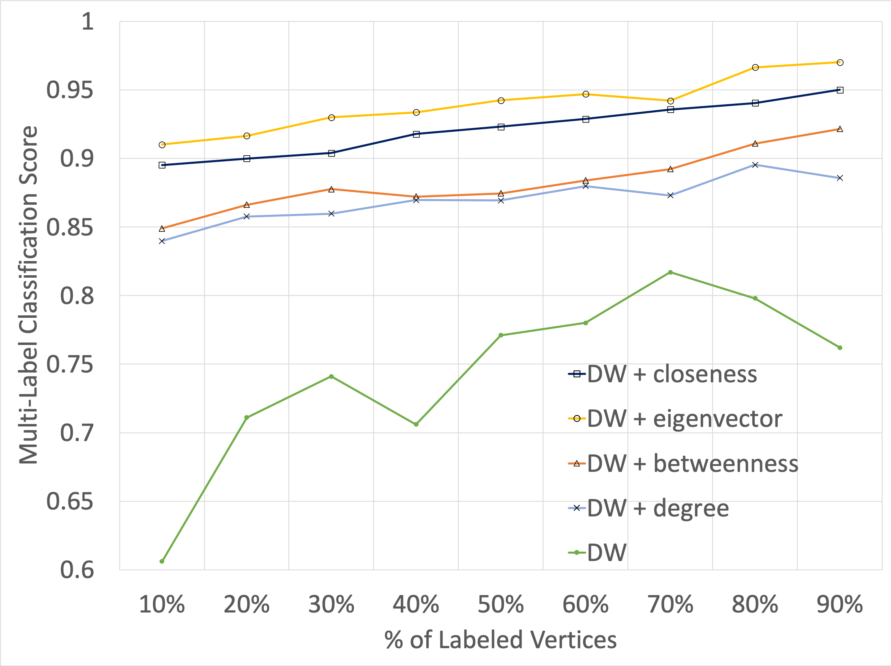
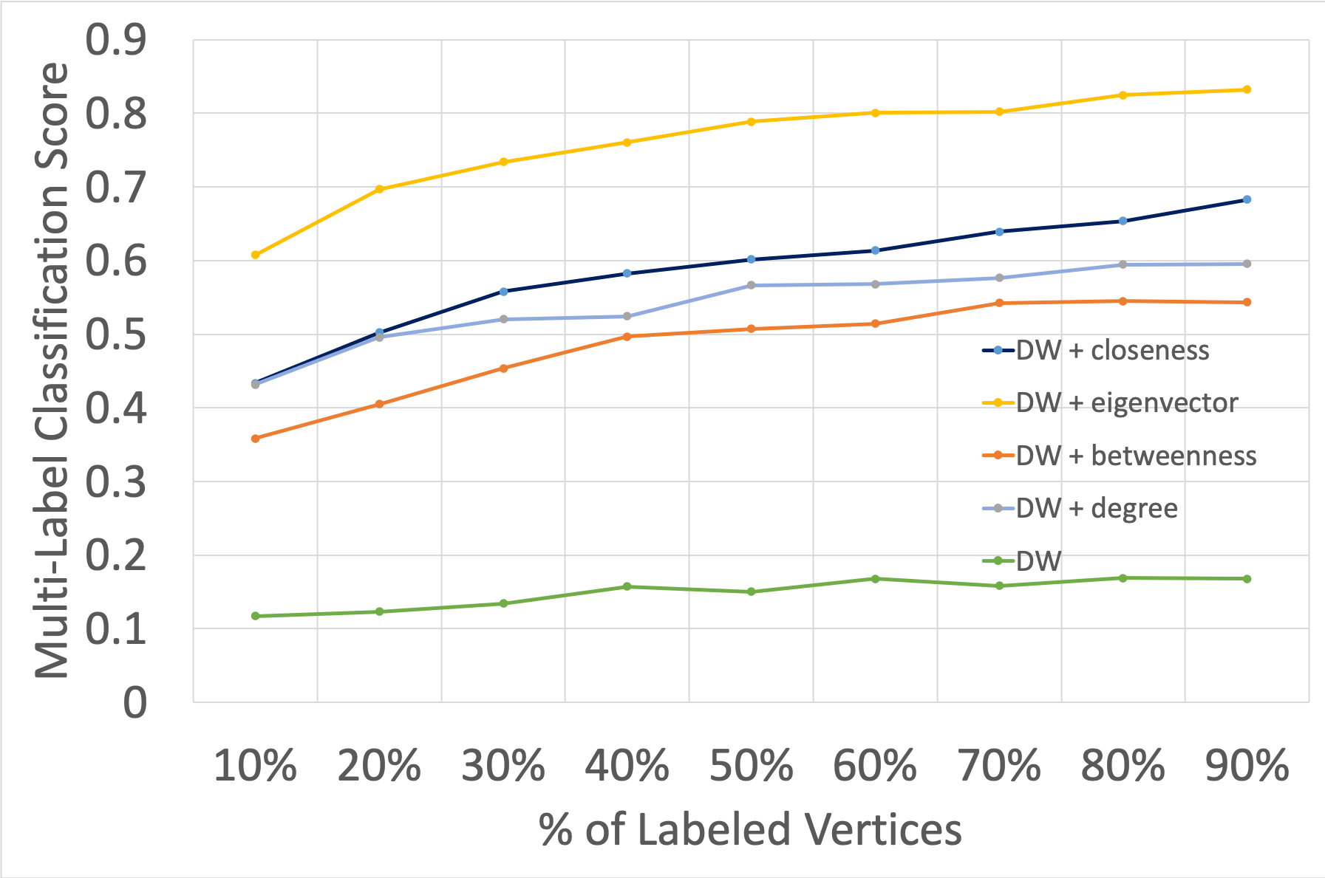
Experiment Result
Result under the same amount of total training resource
Performance under different centrality (UK)
Performance under different centrality (Olympics)

Slide 15
Reference

